Slide 1
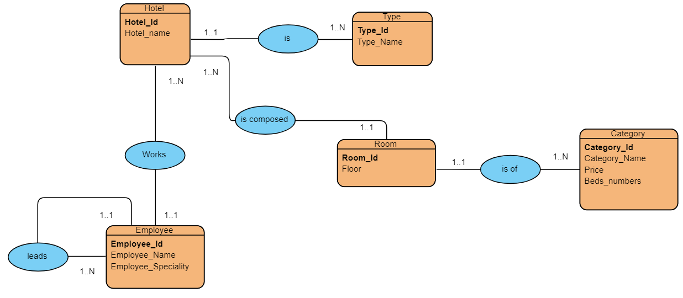

Convert the entity relationship model to a relational diagram

Slide 2
Hotel(Hotel_id,Hotel_name,#Type_id)
Type(Type_id,Type_name)

Slide 3
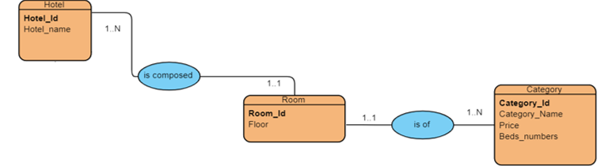
Hotel(Hotel_id,Hotel_name,#Type_id)
Room(Room_id,floor,#Hotel_id,#Category_id)
Category(Category_id,Category_Name,Price,Beds_Numbers)

Slide 4
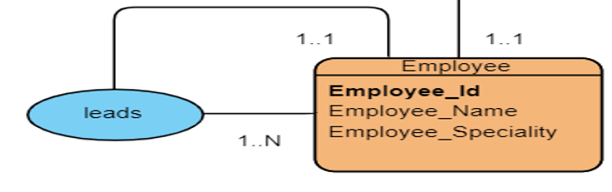
Employee(Employee_id ,Employee_Name,Employee_Speciality,#Employee_id)

